Slide 1
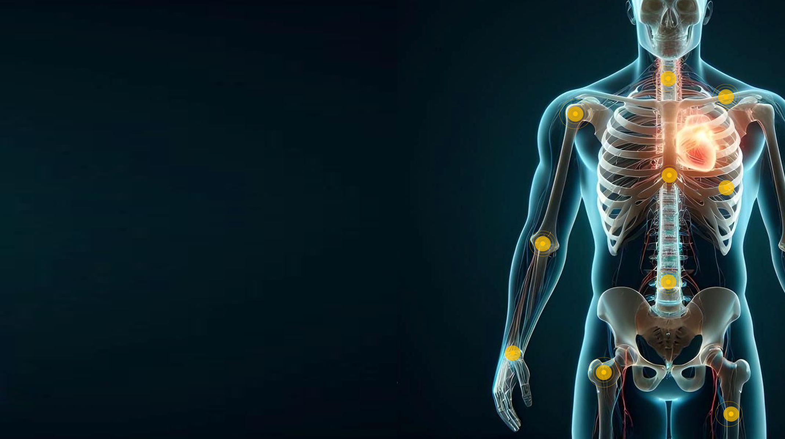

Making Orthopedic Implants SMART
Real-Time Insights from Inside the Body

Slide 2
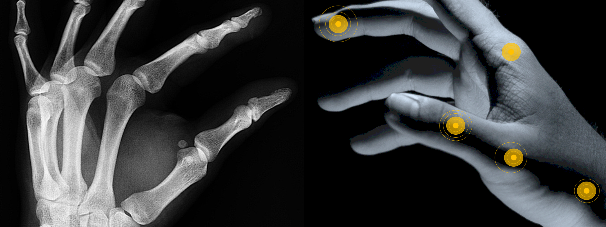
From Images to Data
From X-rays to Smart Implants
In 20 years, every orthopedic implant will be SMART.

Slide 3
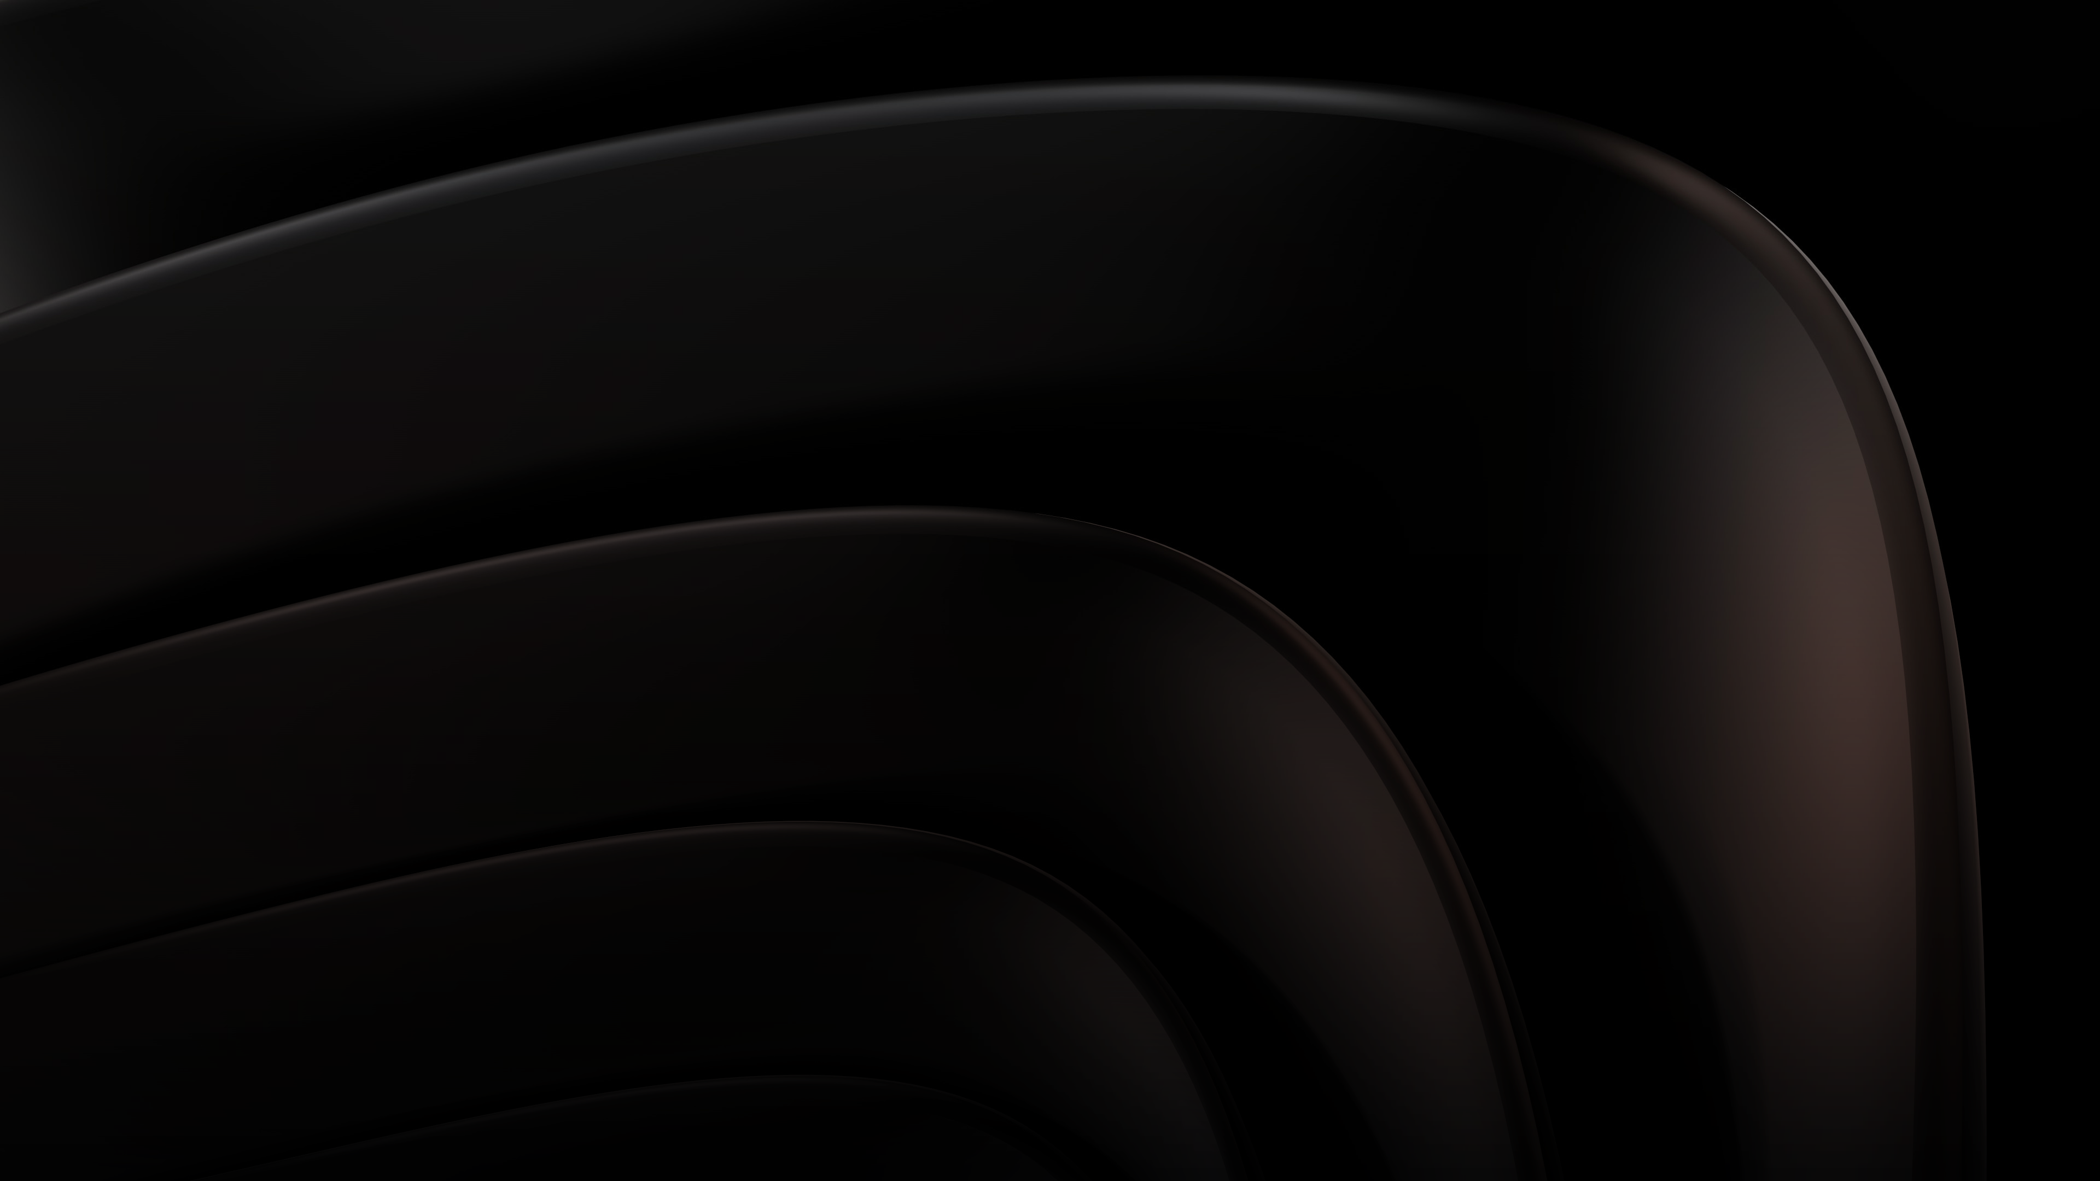
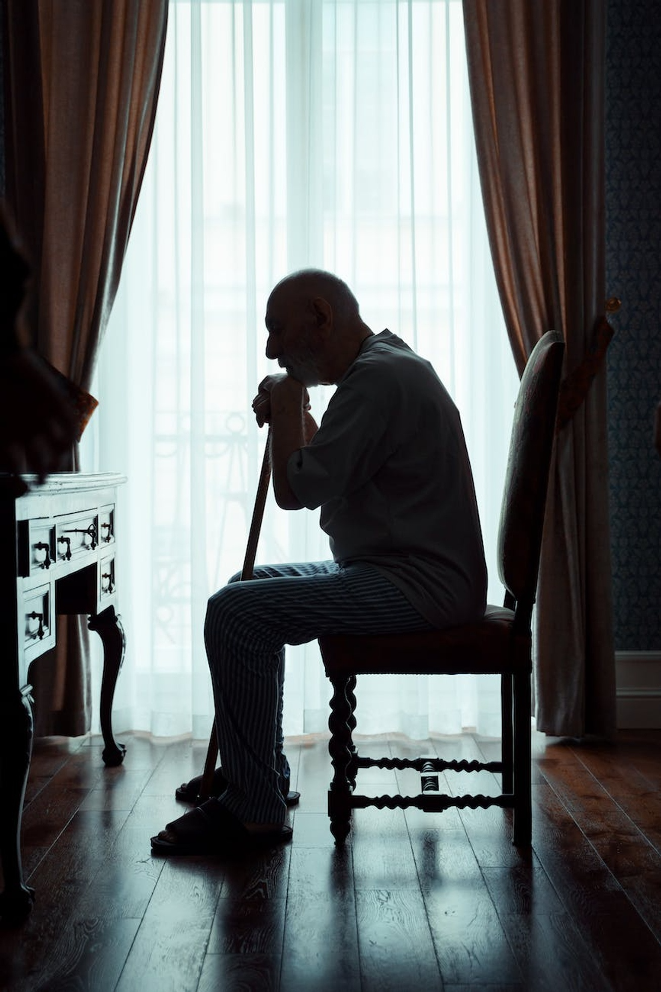
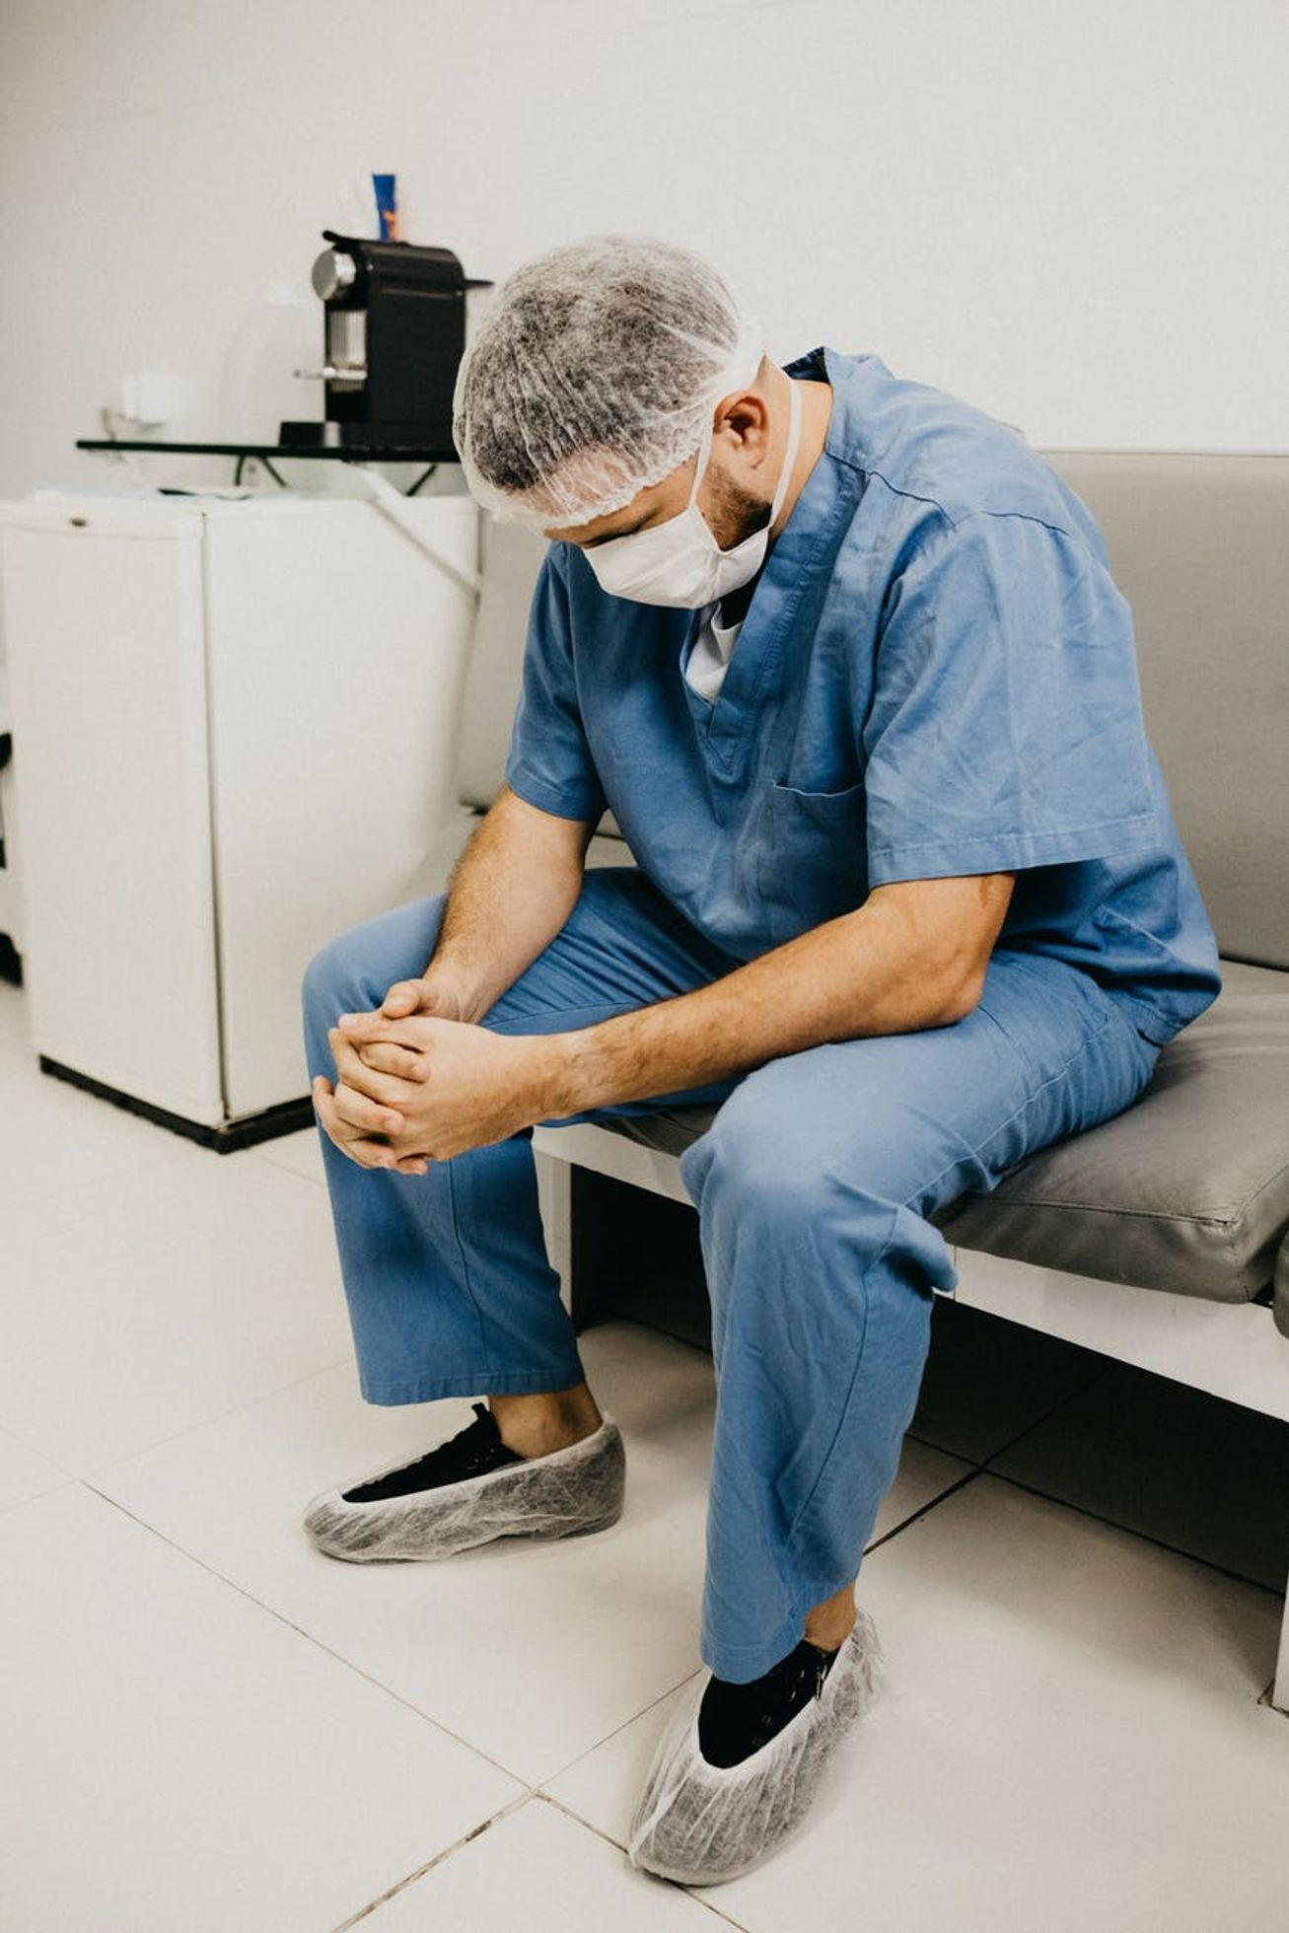

Our first challenge
Hip Fracture - a global health crisis
A death sentence
Healthcare is overloaded
Tidal wave coming
1 out of 2 die or loose independence.
Patients are left alone.
13M care-givers will be missing by 2030
2M hip fractures today, 7M by 2050.
(MAGAZINER ET AL. 2015)
(WHO)
(COOPER ET AL. 1992)

Slide 4
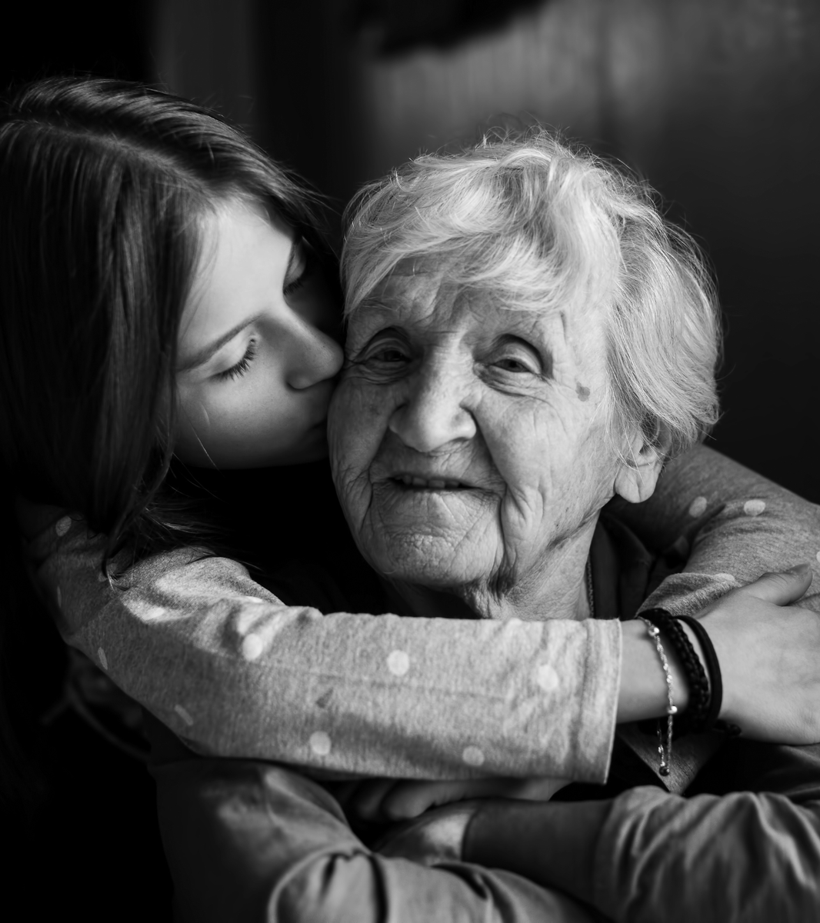
We need
Personalized rehabilitation
Every patient should receive the care needed. Not too much, not too little - based on facts.
A proven fact: Sensor data significantly improves the recovery (Pol et al. 2019) ...

Slide 5

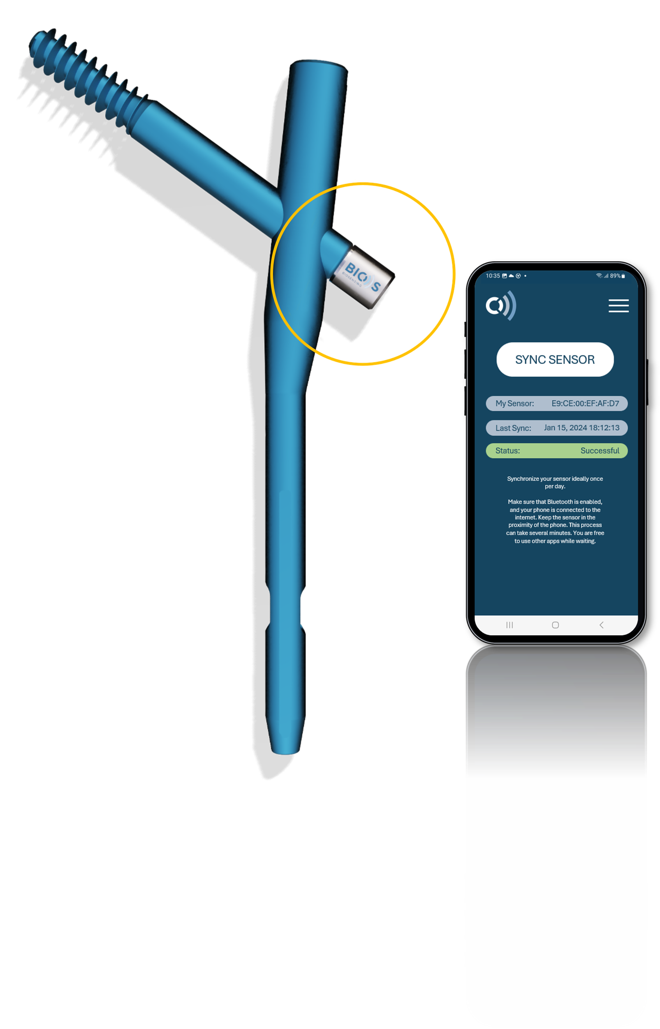
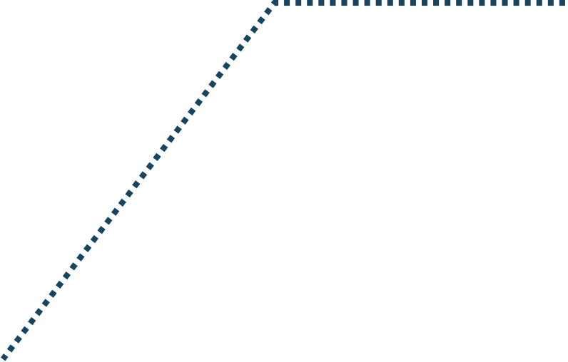

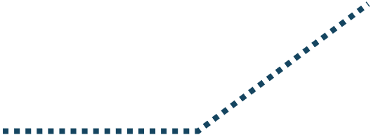


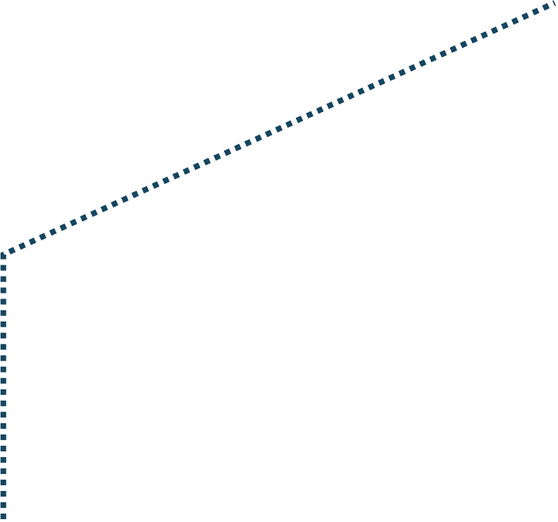


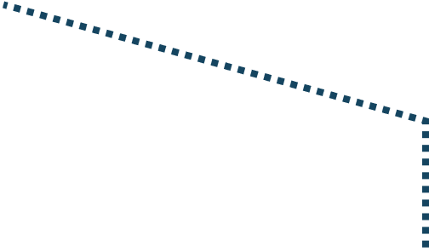


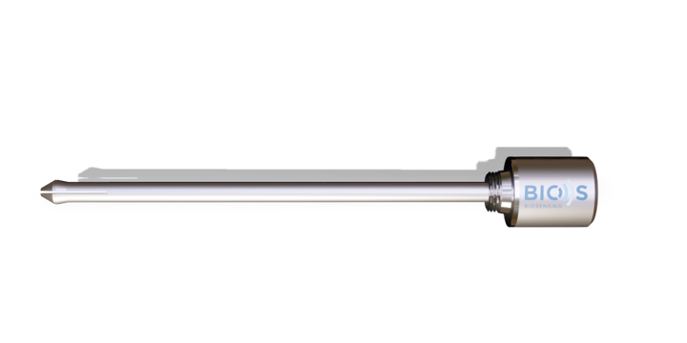

Attaches to the hip screw when fixing the fracture
... that's why we develop
The world's first implanted hip fracture recovery sensor
Works with standard implants
Operates continuously and long-term
Connects to the patient's smartphone
Patent pending

Slide 6


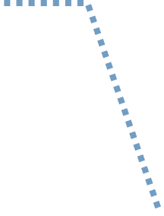
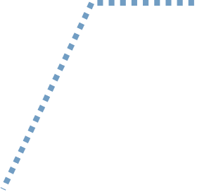
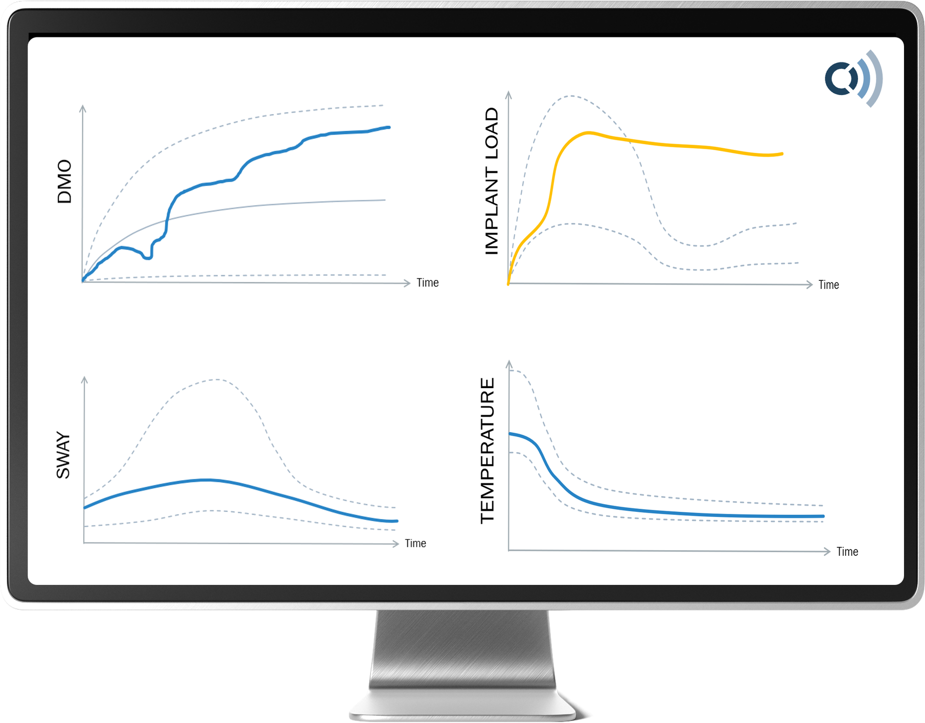
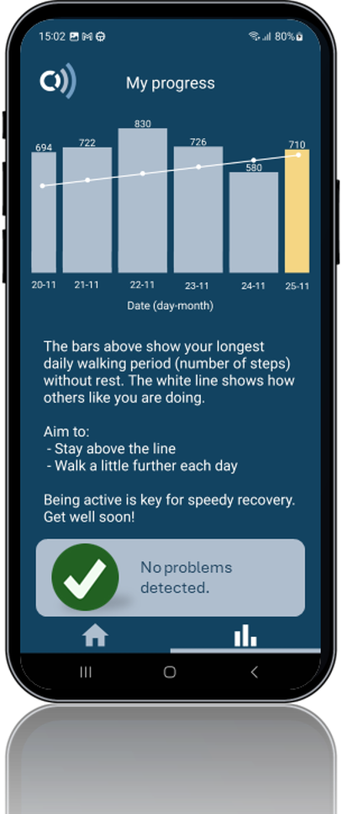




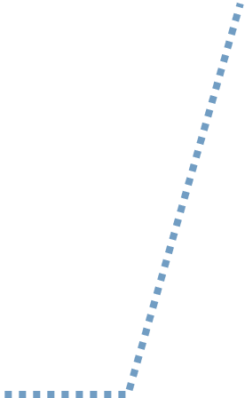
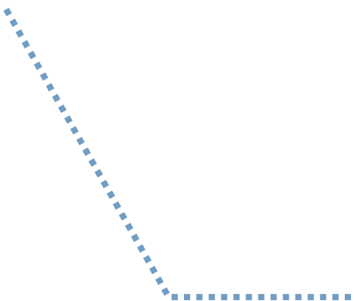
Empower the Doctor
Empower the Patient
ALL THE DOCTOR NEEDS TO TAKE INFORMED AND IMMEDIATE ACTION
PATIENTS CAN TRACK THEIR PROGRESS IN REALTIME AND ADAPT
Healing problems
Mobility
Implant failures
Cut-out
Fall prevention
Infections

Slide 7
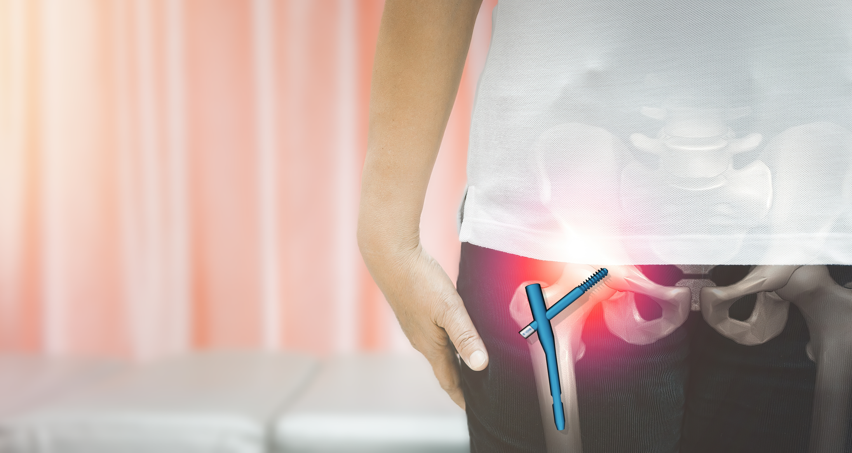






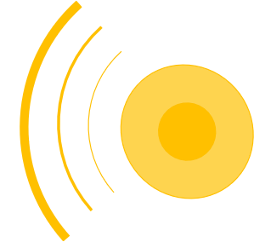

We create value for patients, hospitals and healthcare systems by
Providing unprecedented visibility on the recovery progress - remotely and continuously.
Shorter length of hospital stay
Fewer hospital readmissions
﻿﻿Fewer hospital follow-up visits
Fewer permanent nursing-home admissions

Slide 8












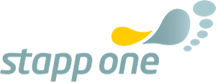



Inside the body
USP
We are the only ones measuring
Forces
kinematics only
INTERNAL BODY FORCES
the essential piece to information to track fracture recovery
Outside the body (Wearables)

Slide 9
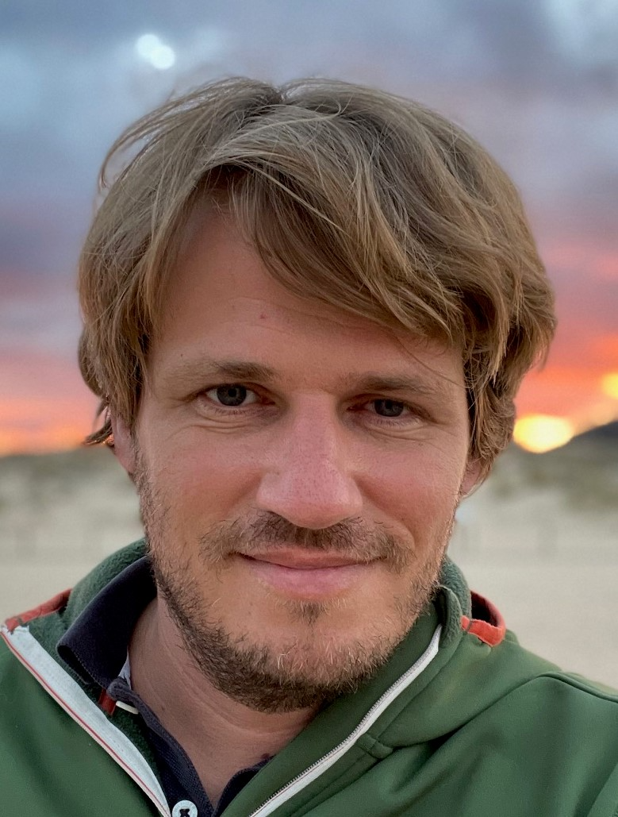
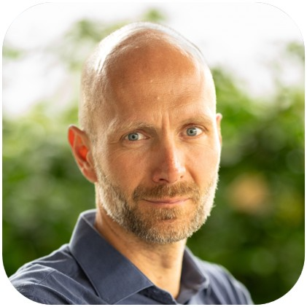
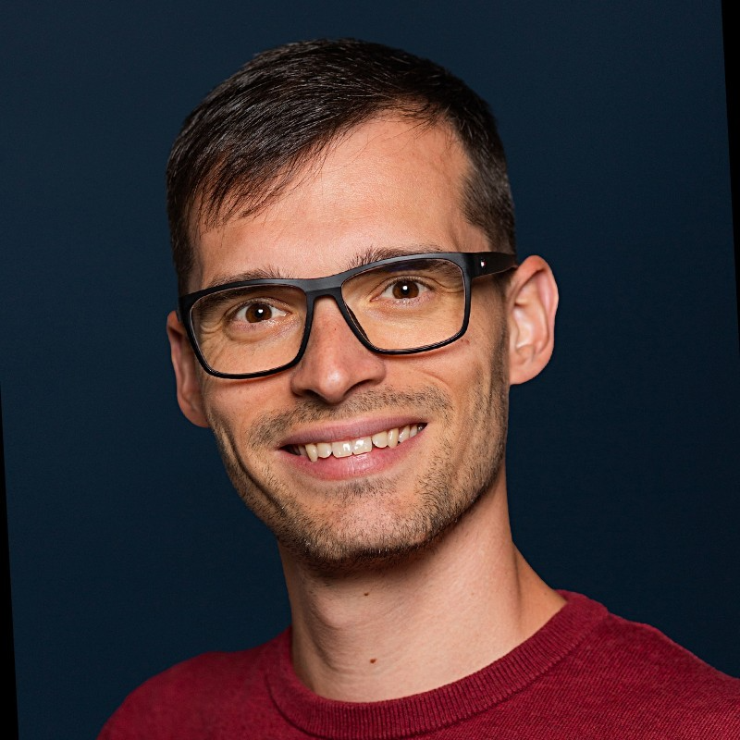
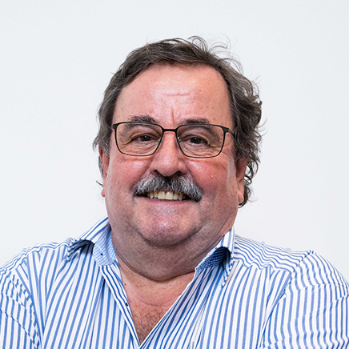
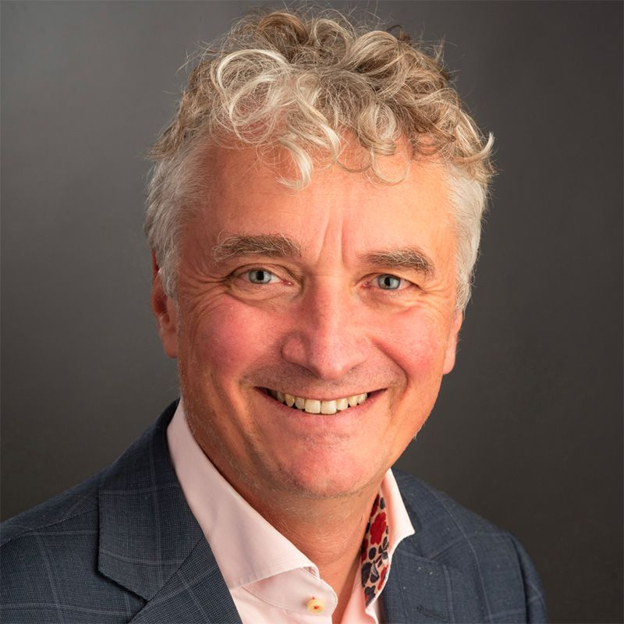
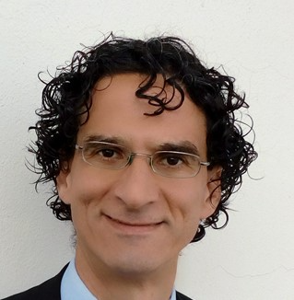
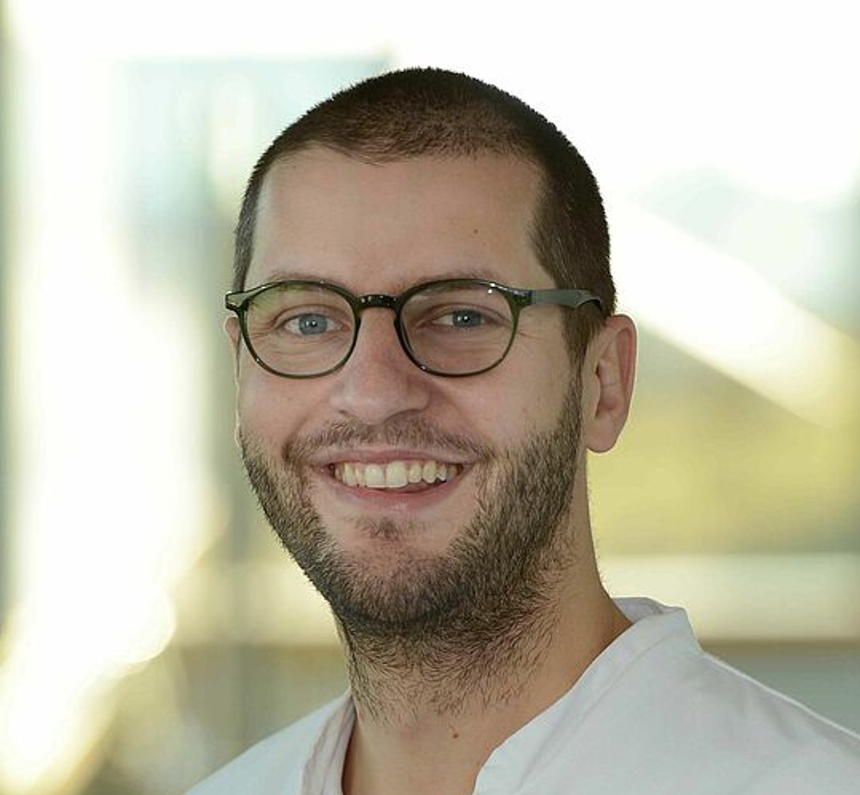
We have done this before …
And made most of the mistakes already.
Markus Windolf (PhD)
Patrick Stepanek (PhD, MBA)
CEO, Founder
COO, Founder
Implanted Device Expert
Serial Entrepreneur
TECH
BIZ
Viktor Varjas
Robert Frigg (Prof.)
Medical Device SW specialist
Former DepuySynthes CTO
Michael Schütz (Prof.)
World-leading Orthopedic Surgeon, KOL
SURGERY
SCIENCE
Bernd Grimm (Phd)
Benedikt Braun (Prof., MBA)
Human movement specialist
Orthopedic Surgeon / sensor-based rehab

Slide 10
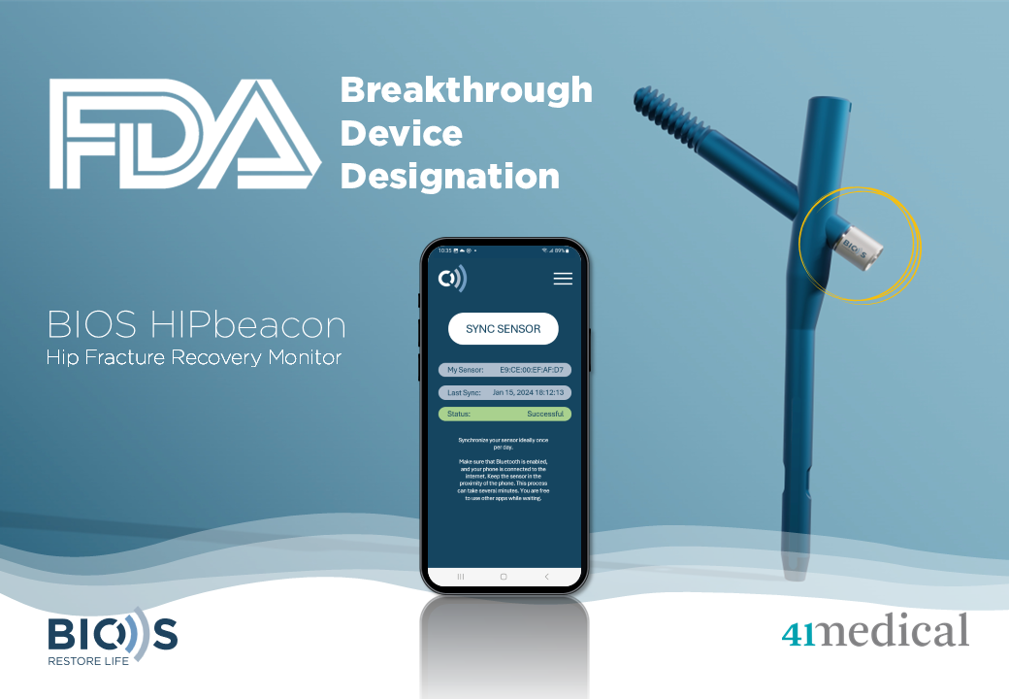
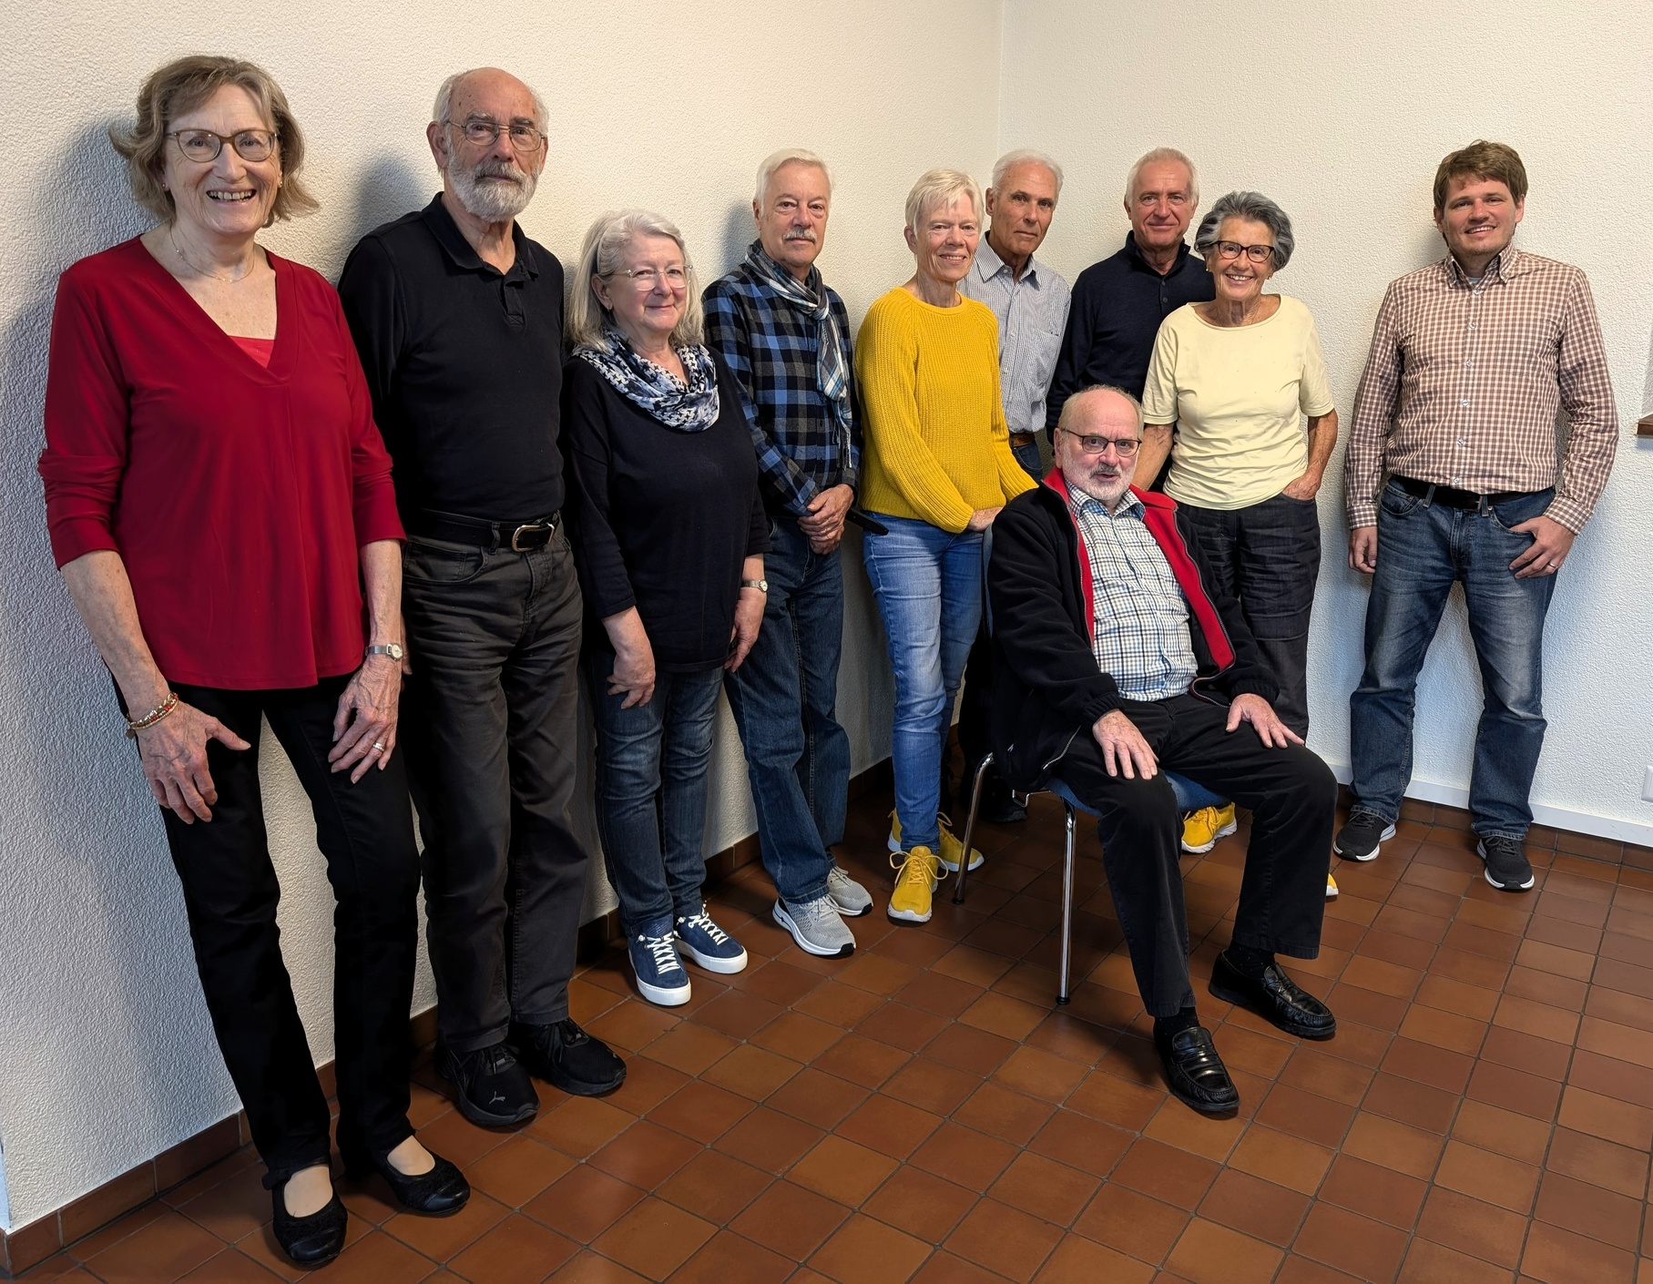
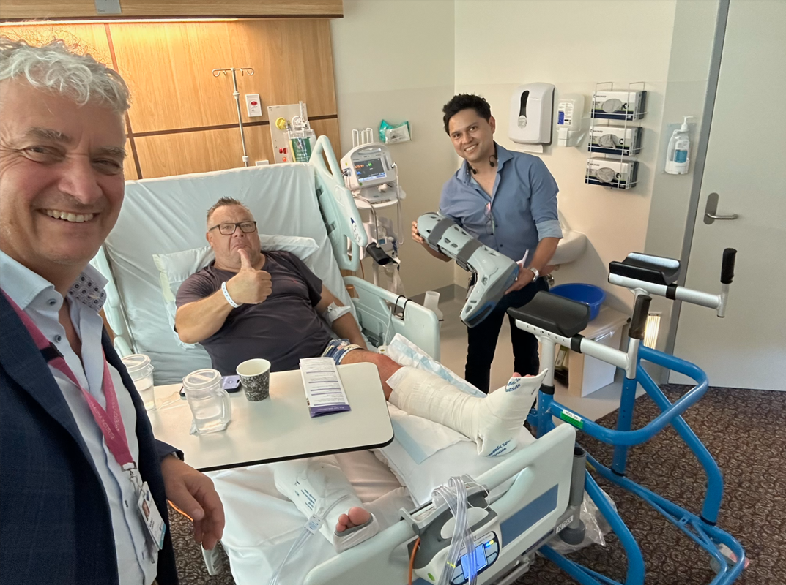
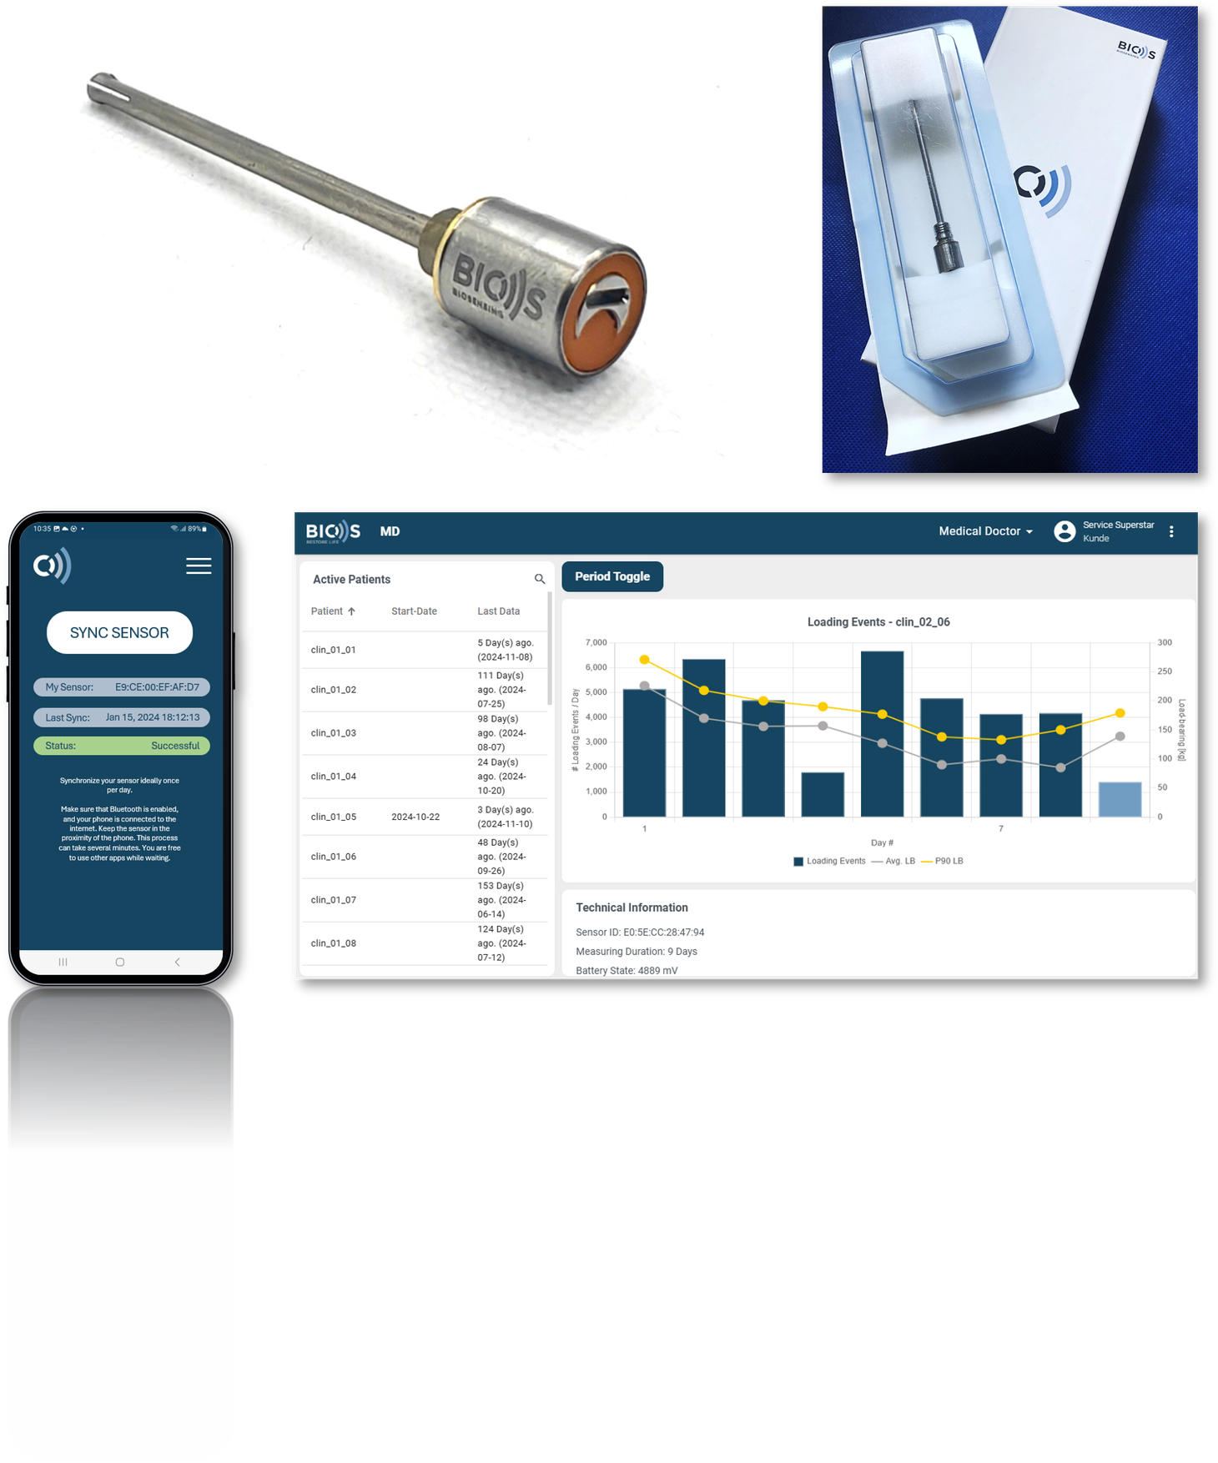
Real-world field test completed.
This is where we stand
First clinical trial completed (external sensor).
Regulatory Design Freeze approaching

Slide 11
Thank You!
www.biosmedical.care

